Slide 1
Using technology to enhance the reach and effectiveness of ACT
Korena S. Klimczak & Michael E. Levin

Slide 2
Disclosure
The USU ACT Research Group owns ACT Guide, a service described in this presentation. Thus, the USU ACT Research Group has a financial interest in ACT Guide.

Slide 3
Comment any questions throughout the talk
You’ll have the opportunity to share via voice chat later after break out groups

Slide 4
Goals
Review the research on self-guided ACT and technology
Present ACT technologies that are currently available and how you can use them in your clinical work
Present supportive accountability principles that can help guide your clients’ uses of these technologies

Slide 5
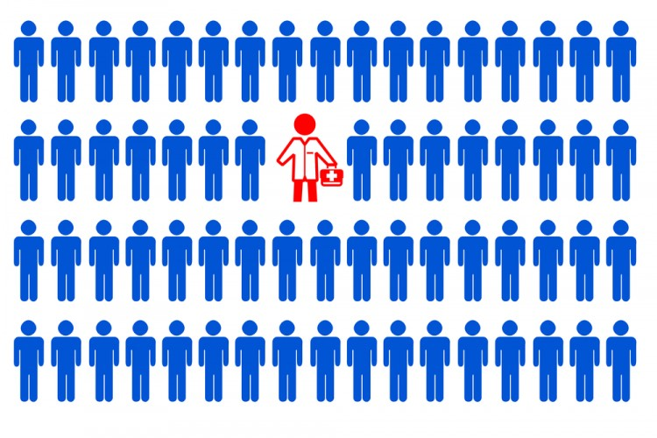
Challenges with service delivery
Supply side challenges
Prevalence of individuals who would benefit from services vs. availability of providers
Challenges with training enough providers in evidence-based treatments
Particularly for specialty problems

Slide 6
Challenges with service delivery
Demand side challenges
Many who would benefit from services do not seek help
Those that do are more likely to seek medications
Barriers
Accessibility
Cost
Stigma

Slide 7
Technology offers solutions
Supply side solutions
Requires fewer resources to serve more clients
Offers resources for gaps in service
Demand side solutions
Accessible immediately from home
Affordable
Reaches those who avoid treatment due to stigma
Self-help resources are scalable, with limited costs per end user

Slide 8
Types of technologies
How can they help?

Slide 9
A review of research on ACT technologies

Slide 10
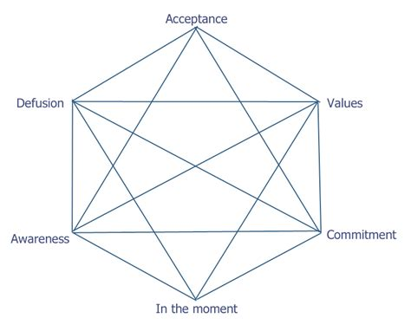
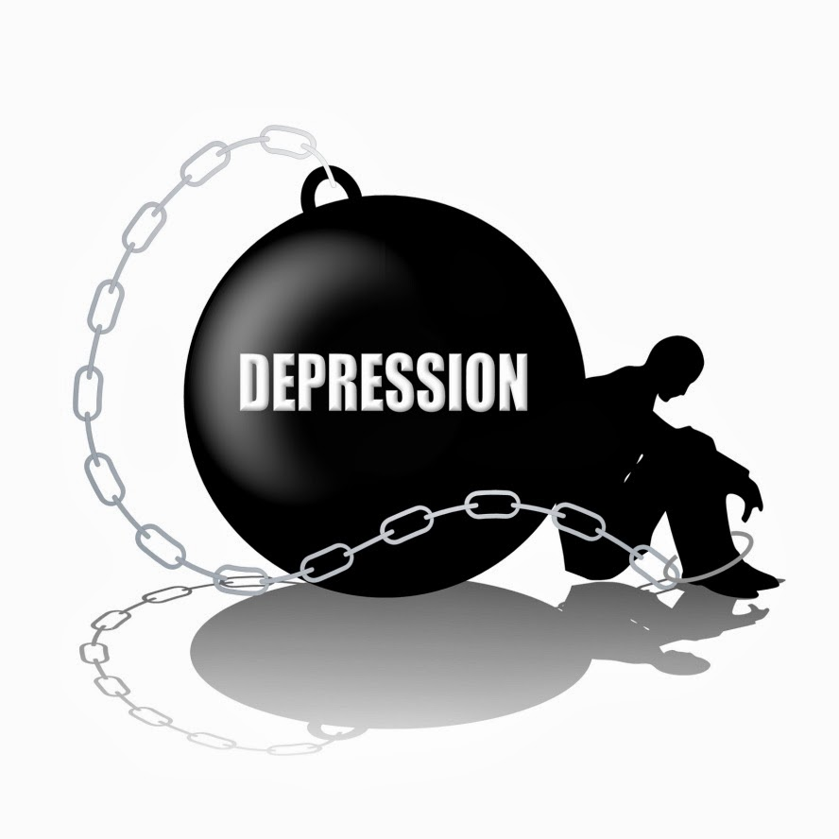
ACT evidence base
Meta-analysis on self-help ACT (French, Golijani-Moghaddam, & Schröder, 2017)
Online programs and self-help books (n=13)
Depression (g=0.34; Z=2.49, p=.01)
Anxiety (g=0.35; Z=2.66, p=.008)
Psychological flexibility (g=0.42; Z=2.93, p=.003)
Psychological flexibility as a mediator
Anxiety (r = -.90, p<.001)
Depression (r = -.70, p<.05)
ACT works, even when done on one’s own

Slide 11
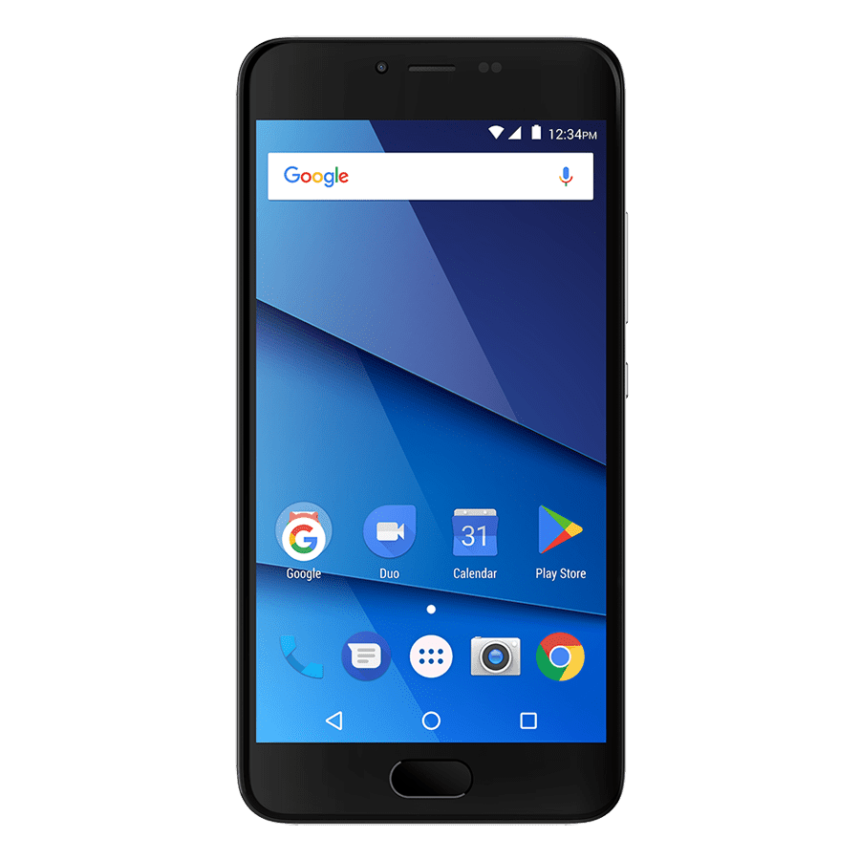
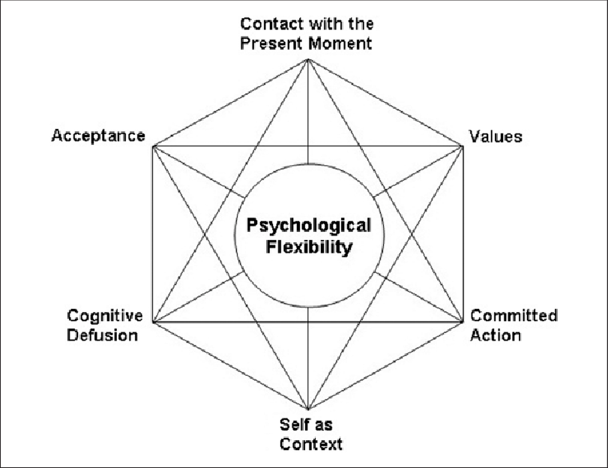
ACT and tech
ACT works with tech because programs…
Are often not disorder specific, suiting a transdiagnostic approach
Can provide interactive/audio guided exercises
Can support homework completion between sessions

Slide 12
Self-help books
Comparable outcomes to online interventions
Online ACT programs can function similar to self-help books
Living to the Full intervention tested in both book and website formats in two different studies
Book adherence: 82.4% (Fledderus et al., 2011)
Website adherence: 84% (Pots et al., 2016)
Both significantly improved depression
But books might have lower rates of completion
https://contextualscience.org/act_books_self_help

Slide 13
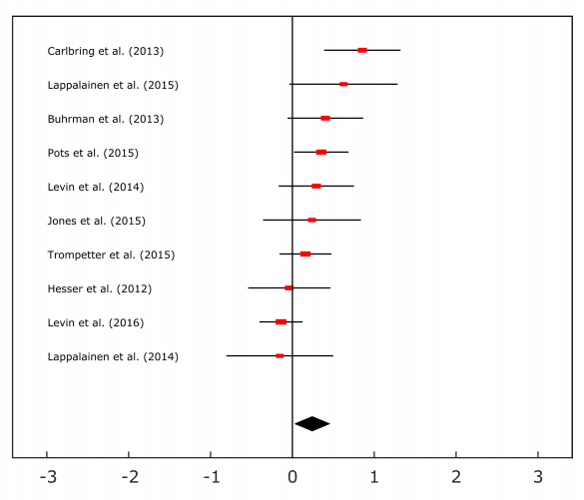
Websites
Like digital self-help books
More personalization/interactivity
Supported by meta-analyses (Brown et al., 2016)
Meta between-group effects
Depression (g=0.24, p=.02)
Anxiety (g=0.18, p=.03)
However, effect sizes vary
Quality of program, sample
characteristics, and study designs
could all be causes

Slide 14
Stand alone mobile apps
Different from websites
Open tool box format more common
Intended more for daily, ongoing use
No meta-analysis of ACT apps specifically, but individual studies exhibit similar effect sizes
Meta-analysis across 27 RCTs of acceptance / mindfulness apps (Linardon, 2019)
Hedge’s g = .32, 95% CI (.16, .48) for depression/distress
Hedge’s g = .29, 95% CI (.17, .41) for acceptance/mindfulness
Changes in acceptance/mindfulness predicted changes in depression/distress in meta-regression

Slide 15
Adherence to self-guided technologies
Adherence is an issue (Baumel et al., 2019)
Adherence of 50% in studies is common
A lot of variance from study to study though
What constitutes adherence is unclear and varies
But adherence is 4 times worse during natural use

Slide 16
Blended interventions
Integrated blended interventions w/ F2F focus
Supplement F2F to increase effectiveness/save time
Integrated blended interventions w/ internet focus
Reduce drop-out in online interventions
Provider can provide tailored services or support role

Slide 17
Blended interventions
Sequential blended intervention: internet -> F2f
Early didactic work can reduce number of F2F sessions
Bridge gap between waitlist and F2F care
Sequential blended intervention: F2F -> internet
“Aftercare” to help maintain gains

Slide 18
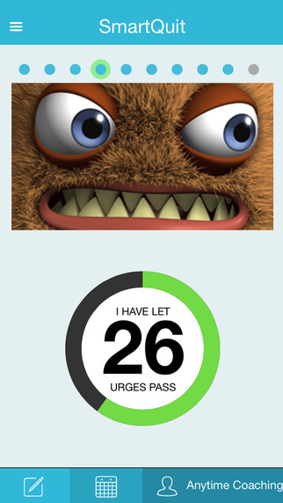
Blending Technology During Therapy
2Morrow Health + group ACT vs. group ACT alone (O’Connor et al., 2019)
Participants quitting smoking randomized to group support control, group ACT, or group ACT with 2Morrow Health app for 6 weeks
Participants in combined group more likely to...
Recommend program to a friend or family member (d=.43, p=.024)
Smoke less cigarettes per day at post-treatment (d=.37; CI [0.73,7.21])
No differences in other satisfaction variables or follow up
ACT Daily Life (van Aubel et al., 2020)
Participants attend group ACT and use ACT-DL app for 5 weeks
App included EMA assessments, with half of prompts including a metaphor and half of prompts presenting a skill

Slide 19
Blending Technology Prior to Therapy
Providing technology for clients waiting for counseling (Haeger, Davis & Levin, In Press; Levin, Hicks, & Krafft, In Press)
Slow recruitment: n = 23 & 11 across 1+ years
High satisfaction ratings and levels of program engagement
Promising effects for improving mental health
Third pilot study in our clinic found (Ong, Terry, Levin & Twohig, Under Review)
Higher recruitment (n = 51), but lower engagement (37 started the program, 25 completed > half of sessions, 13 completed program)
But ~75% reported clinically significant change post-program and pre-therapy
Technology seem helpful to waitlisted clients who use them, but only a minority may be interested

Slide 20
Summarizing the data
ACT still works in self-help formats
Self-help books function/perform similarly to websites
But adherence/completion rates are hard to compare
Think about what format makes sense to use with your client
Websites/apps work, but adherence can vary widely
Don’t treat websites/apps as one-size-fits all solutions
Assess the quality of programs critically
Tech can be blended with therapy in several ways
Again, what makes sense for the client? Be open to different modes of implementing tech.

Slide 21
Using ACT technologies in your practice

Slide 22
Questions We Often Have
How would I use technology in my clinical work?
For what role and function?
How do I navigate all of the technologies that are available?
How do I know which technology to choose for this client?

Slide 23
What functions would you want a technology to serve clinically?
BREAK OUT GROUPS!
How might you use technology in therapy?
How might it help your clients?
How have you used tech in the past?

Slide 24
Think Pair Share: Functions of Tech
Raise your hand or type in the chat box to share your thoughts

Slide 25
Enhancing ACT work with technology
Targeting skills
Skill acquisition – Introducing it
Skill strengthening – Learning more
Skill generalization – Applying it across contexts
Goal setting
Self monitoring
Assessment feedback
Crisis support
Social engagement/support
Communicating with therapists
Homework/Practice between sessions

Slide 26
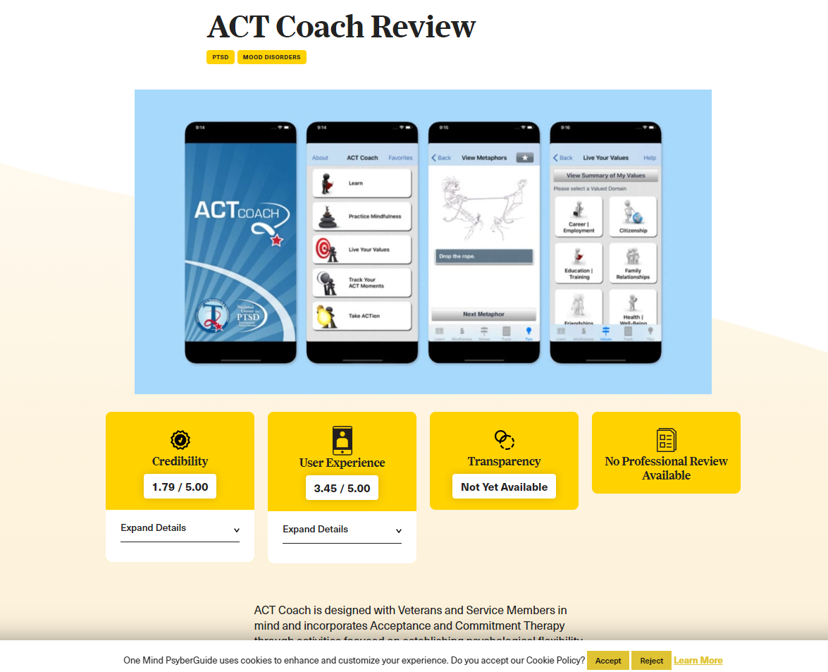
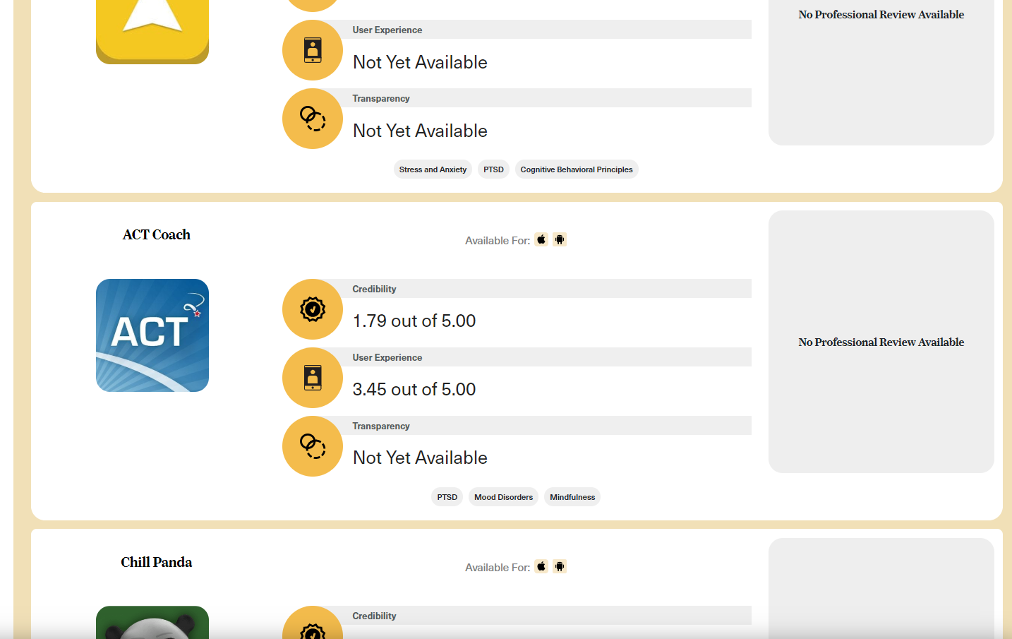
Technology Handout
See our handout for apps we recommend
https://bit.ly/2C9txEK
Many other apps out there… seek apps that best serve your intended function
https://psyberguide.org/
Online mental health app guide
Plenty of mindfulness apps
But lacking in ACT apps

Slide 27
A quick comment on apps and websites
The gap between what has been researched and what is available to the public is very large
In general, there are many more apps than there are research studies
But in some areas there are few available apps relative to studies
There are very few up-to-date, publicly available websites
But there are many studies on websites
Torous, Levin, Ahern & Oser, 2017

Slide 28
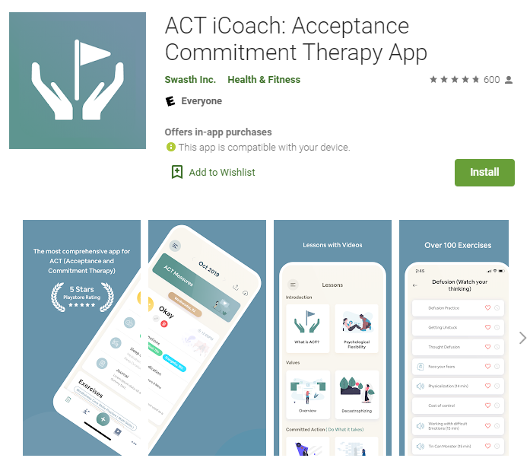
Exercise caution when looking for programs
ACT iCoach is the first app to return when you search "acceptance and commitment therapy" on the Play store
Feels very legitimate
Good reviews
But content is plagiarized and includes ACT inconsistent language
When choosing apps...
Check psyberguide
Look to see who developed it

Slide 29
A list of available ACT websites
Name | Price | Link
ACT Guide | $10 | https://scce.usu.edu/services/act-guide/
The Happiness Trap | $295 (sometimes goes on sale) | https://thehappinesstrap.com/
6 ACT Conversations | Free | https://emedia.rmit.edu.au/communication/content/1_Language/00_intro.htm
ACT For Life | Free | https://www.exeter.ac.uk/wellbeing/support/self-helpandpeersupport/onlineselfhelp/act/
ACTOZ (Cancer) | Free | http://josephciarrochi.com/ACTOZ/index.html
Life After Pornography (Porn addiction) | $97 | https://www.lifeafterpornography.com/
VA LifeGuard (Veterans) | Free | https://www.mirecc.va.gov/apps/activities/lifeguard/index.html#&panel1-6
Lifðu betur (Icelandic) | 14,000 kr. | https://lifdubetur.is/

Slide 30
A list of available ACT apps
Name | Platform | Price
ACT Companion | iOS | Trial, $3/month or $6/3-months or $15/unlimited
ACT Coach | iOS/Android | Free
I Here Now | iOS | $3/unlimited
ACTive: Value based living | iOS | Free
Sleep School for Insomnia | iOS/Android | $8/month or $50/year
Blue Life Coach | iOS/Android | Free
ACT Mindfully (Italian) | Android | $6.50 - $185
ACT iCoach – not recommended | iOS/Android | Trial, $8/month or $40/6-months
There are other apps that aren’t directly downloadable
2Morrow Health
Learn2ACT
Oiva (Finnish)

Slide 31
ACT Guide
https://scce.usu.edu/services/act-guide/
Low cost
$10 for 6 months of use
Structured format
12 online sessions to be completed at own pace
More in depth than typical mobile apps
20 – 40 minutes per module -> 6 hours total

Slide 32
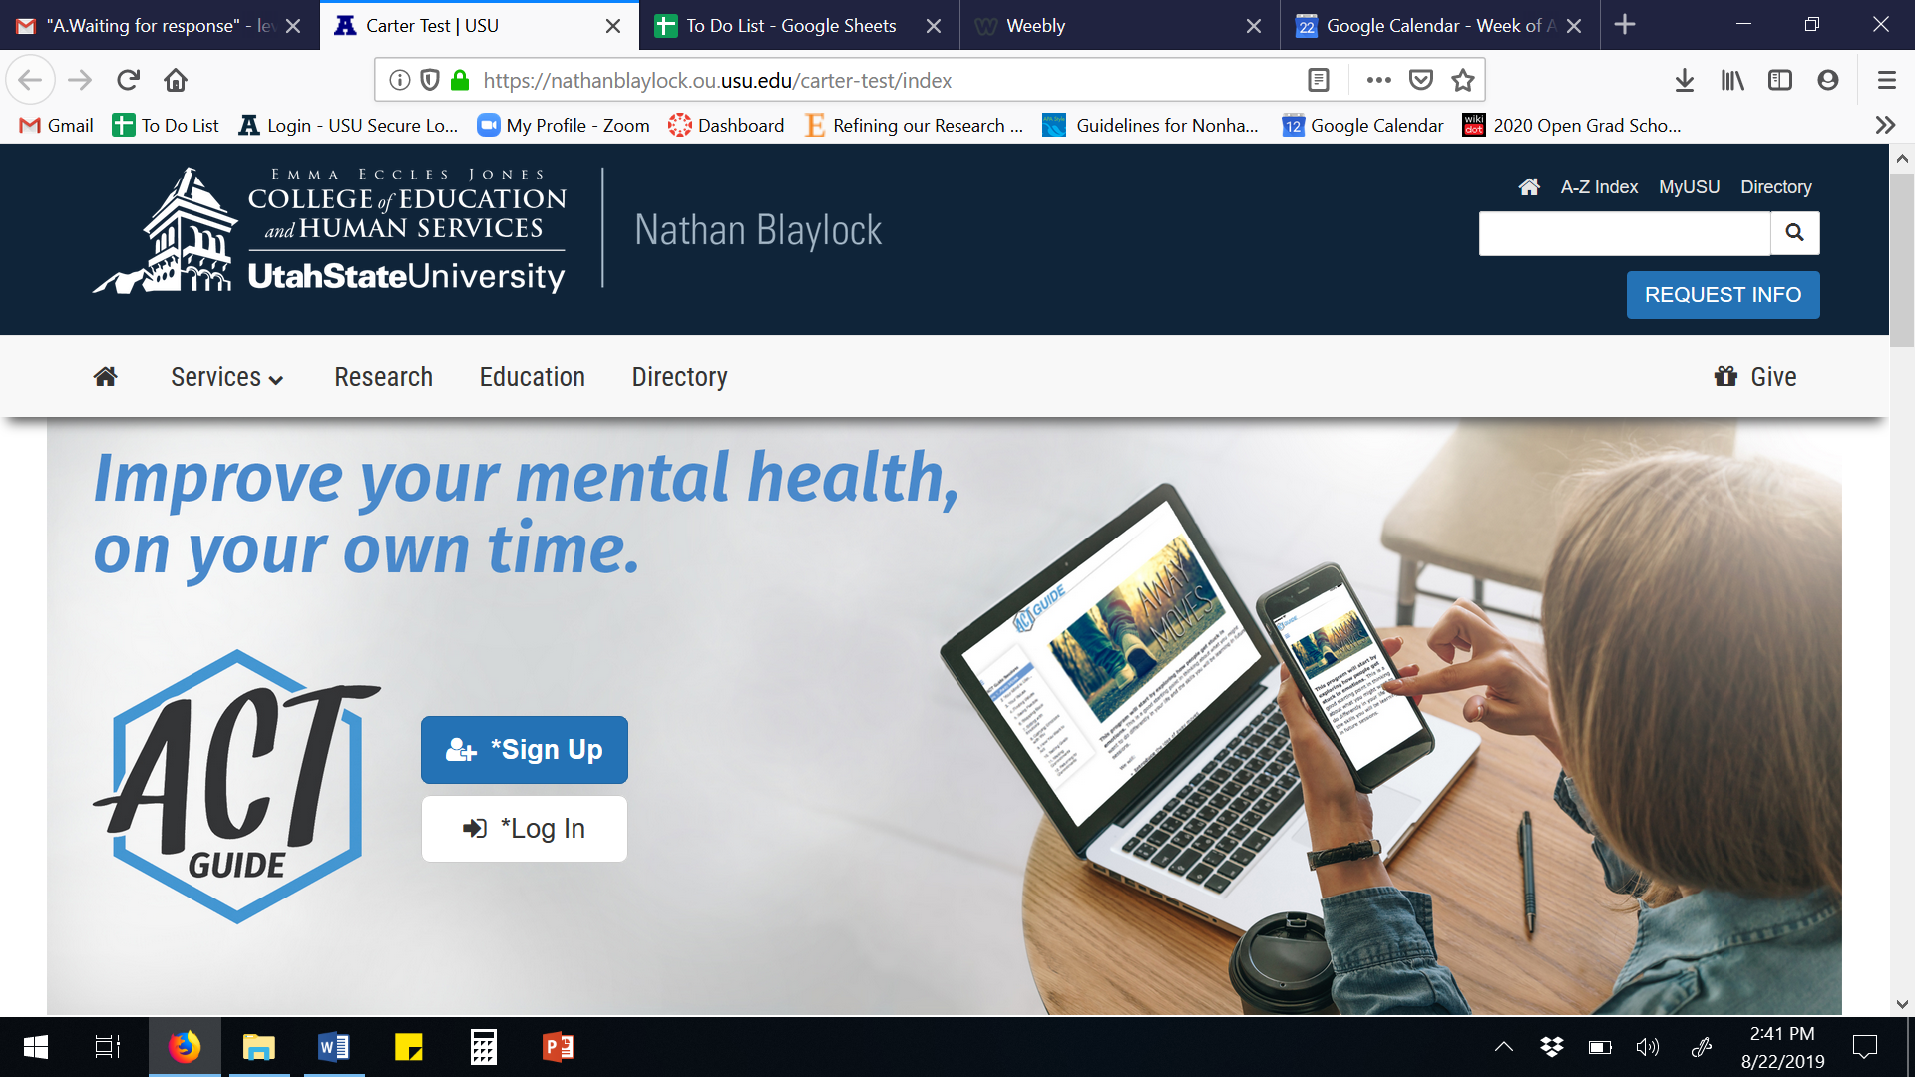
ACT Guide demo
https://scce.usu.edu/services/act-guide/

Slide 33
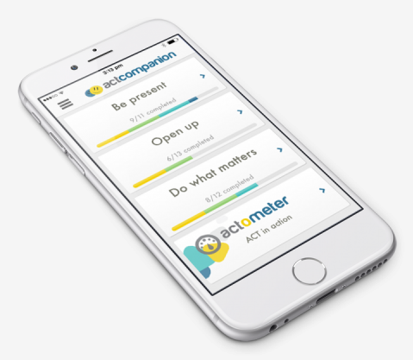
ACT Companion
http://www.actcompanion.com/
Low cost
Free trial -> $14 for unlimited use
Self-monitoring
Skills practice
Exercises requiring short written responses
Guided audio exercises
Used to be on Android but not anymore

Slide 34
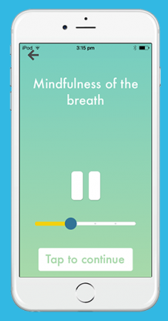
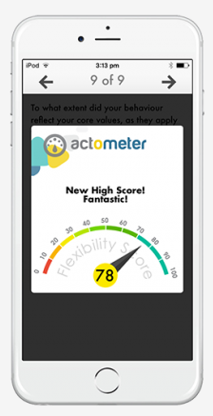
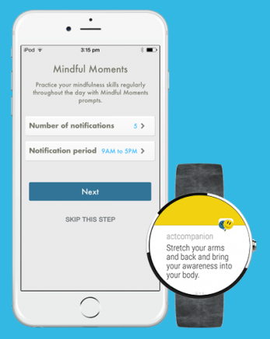
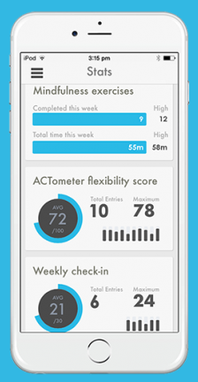
ACT Companion

Slide 35
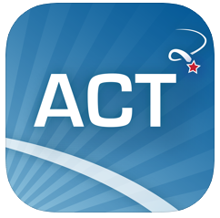
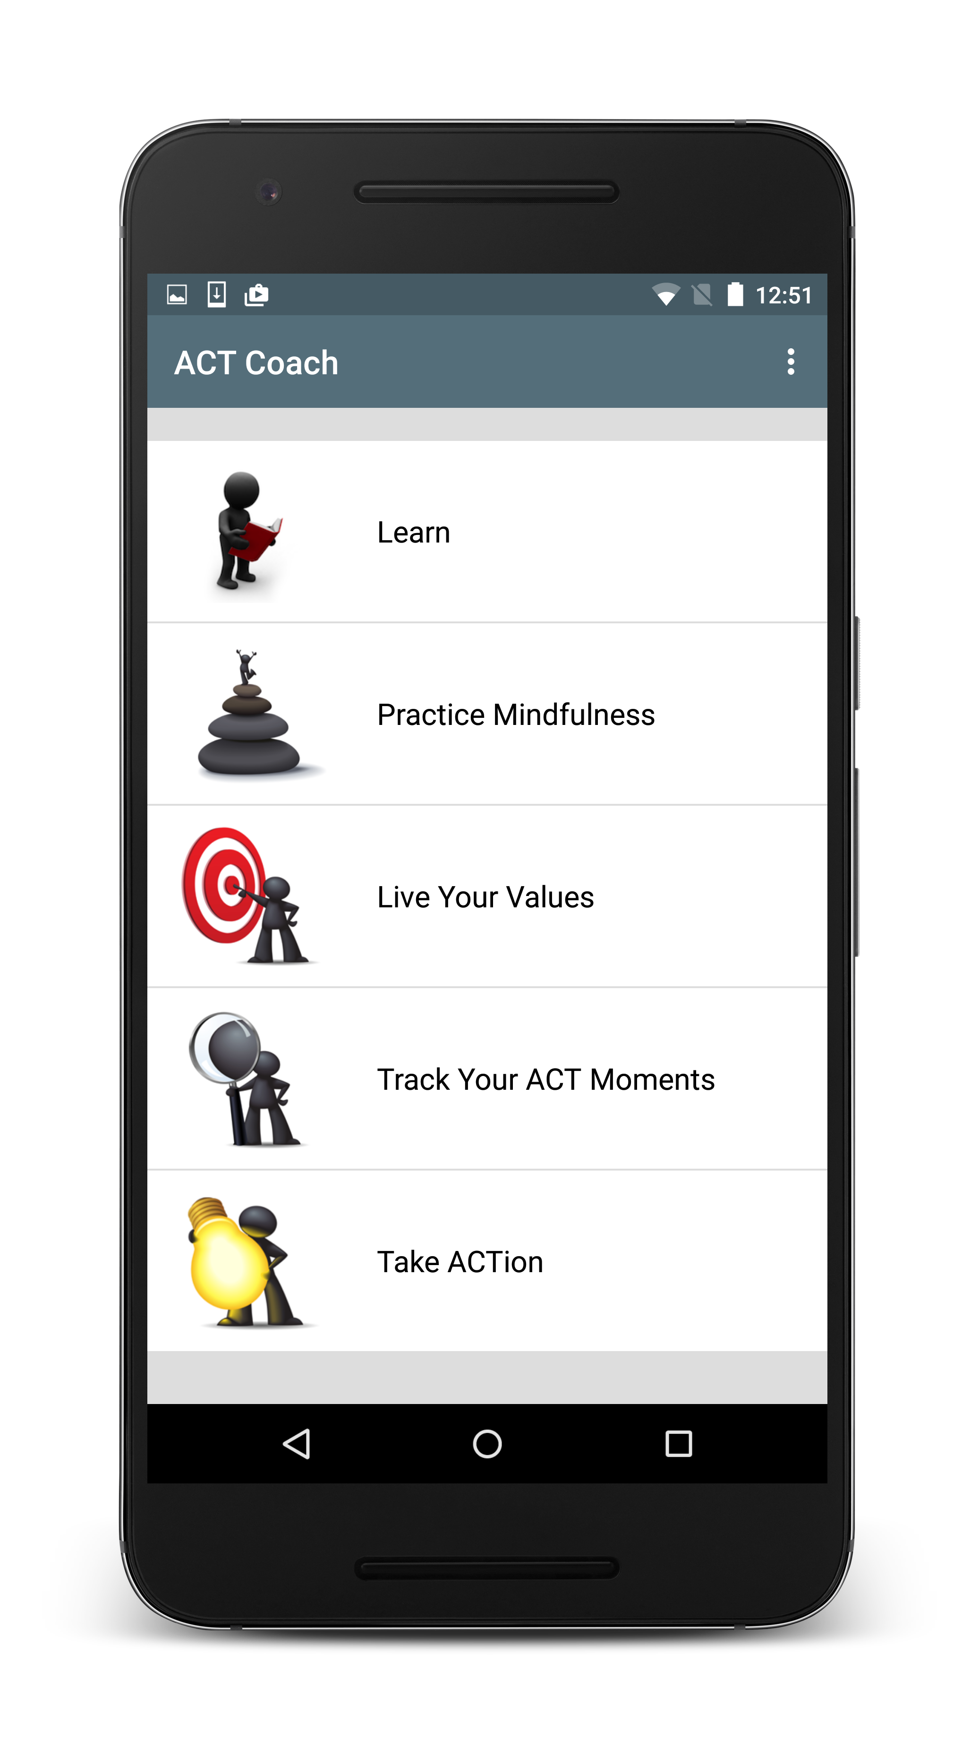
ACT Coach
https://mobile.va.gov/app/act-coach
Free
Text-based lessons
Exercises
Mindfulness
Values-based goal setting
Self-monitoring
Mindfulness, coping, willingness

Slide 36
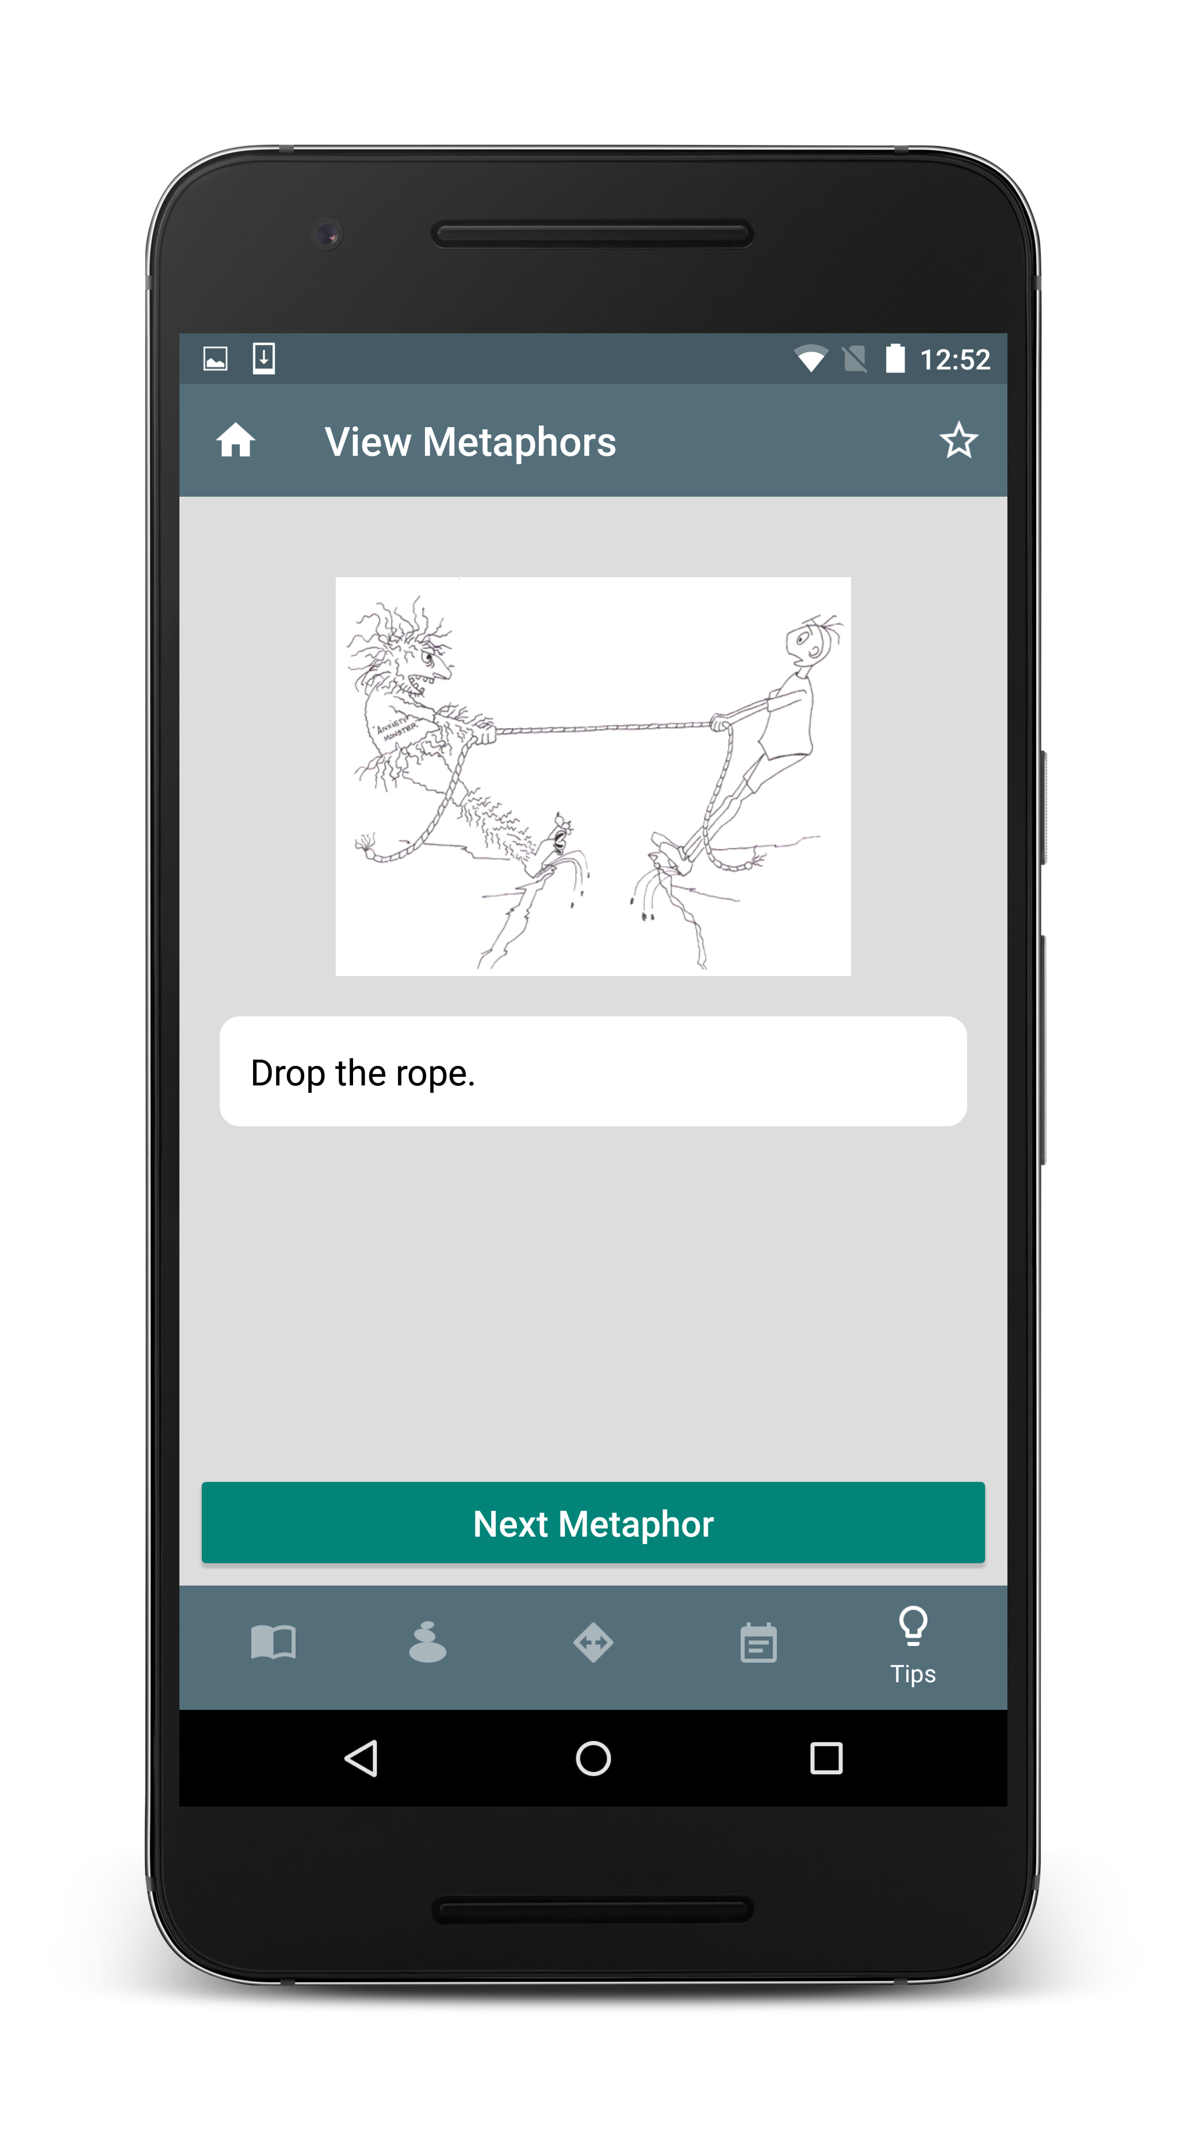
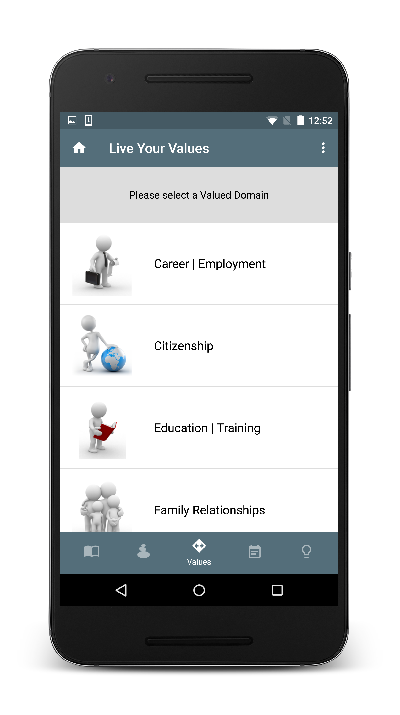
ACT Coach

Slide 37
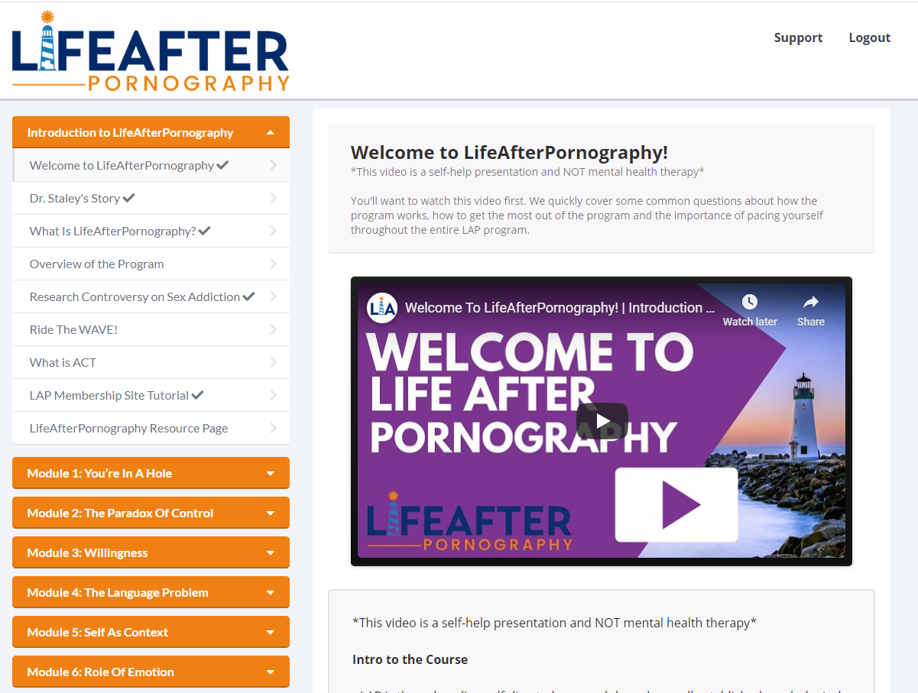
Life After Pornography
https://www.lifeafterpornography.com/
ACT based website for porn addiction
Lessons are in video format
Supplemented by pen-and-paper workbook
One of the few ACT programs tailored toward a specific problem

Slide 38
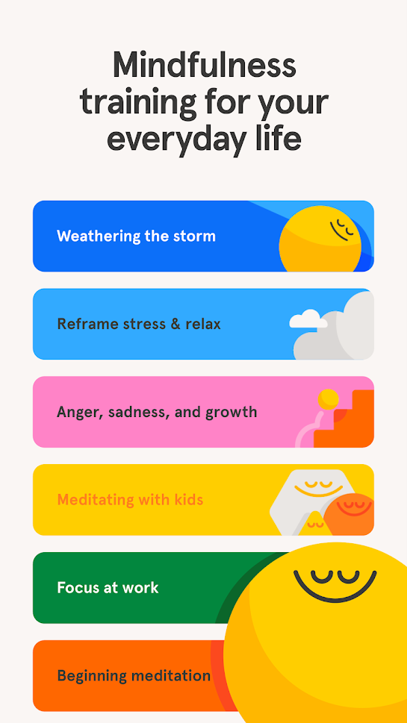
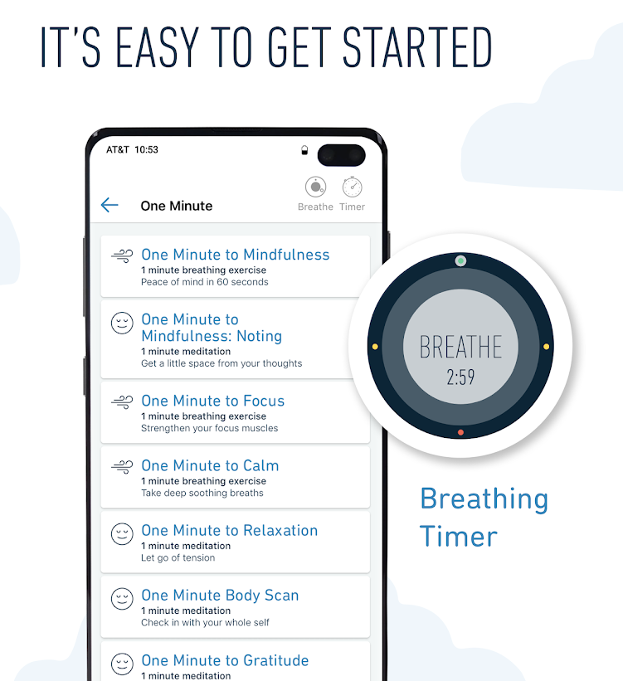
Mindfulness apps
Headspace
Can be expensive, free trial -> $70/per year
Good option for students, only $10/per year
Very polished appearance, easy to navigate
MyLife Meditation (Stop, Breathe & Think)
Price of premium version is comparable to Headspace ($60/year)
But free version offers more than HS’s trial
Check-in follows up with tailored skills options
Exercises for racial minorities

Slide 39
A few non-ACT apps
Many free apps that offer general help or target specific problems
The VA’s apps are often research/evidence-based
COVID Coach
Skills for several general areas
Example of how apps can offer adaptive and accessible solutions
Virtual Hope Box
Offers tools for coping in the moment of crisis
PTSD Coach
Exercises tailored to reported symptoms

Slide 40
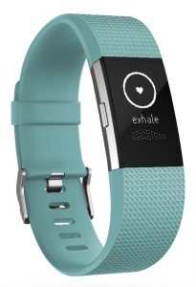
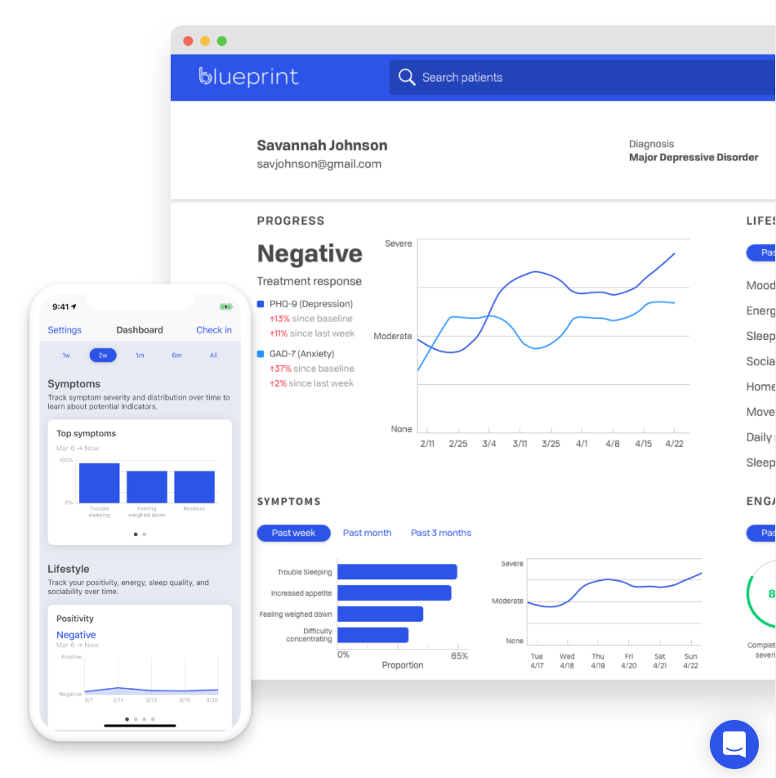
Other ways to integrate tech into treatment
Wearables (Fitbit, Apple Watch, etc.)
Monitor sleep with greater accuracy
Monitor physical activity, if that’s a valued goal
Smartwatch apps designed to detect onset of panic attacks and respond with breathing exercises are in development…
YouTube videos
Mindfulness/meditation exercises
Videos to help explain/review ACT content https://www.youtube.com/channel/UC-sMFszAaa7C9poytIAmBvA/videos
Websites for measurement informed care
Blueprint https://www.blueprint-health.com/
30+ ACT measures are built in, clients can fill out daily measures on app
Cost: Free - $35/month, depending on insurance factors

Slide 41
What are your favorite apps and websites to use with clients?
Type them into the chat box along with why you like it or how you use it clinically

Slide 42
Overcoming barriers and picking apps

Slide 43
Self-guided resources aren’t for everyone
Not everyone wants to or will use self-guided resources
Students less likely to use or prefer self-help than in-person supports
Accrual rates testing self-help tech before/during therapy are very low
Participants have mixed reactions to adjunctive tech
Some concerns this might replace in-person therapy services
A notable percent have little to no engagement in self-help tech in studies (25-50%)
But these are excellent resources for some
Self-help may reach people who would otherwise not seek help (13-27%)
Around 50-75% are adherent to self-help tech in many studies
It may be of interest to those with high stigma or encounter other barriers to service
It may depend on how tech is introduced and used
Levin, Krafft & Levin, 2018; Levin, Stocke, Pierce & Levin, 2018

Slide 44
Barriers to using technology
BREAK OUT GROUPS!
What are the barriers to using self-guided technologies?
Who might be more or less likely to be interested in these technologies?
How might these barriers get in the way of you using these technologies with your clients?

Slide 45
Think Pair Share: Barriers to Tech
Raise your hand or type in the chat box to share your thoughts

Slide 46
What are some of the barriers?
Finding and knowing which apps are credible and effective
Perceived helpfulness and concerns it won’t be relevant
Privacy concerns
Competing contingencies and response effort

Slide 47
Common barriers reported by therapists
Not having enough guidance on which apps are credible and effective
Ethical concerns if clients report being suicidal over app
Concerns about privacy of client data
Low evidence base for mobile apps
Concerns about credibility of mobile app developers
Availability of apps for target populations, non-English languages, and special needs
Pierce, Twohig & Levin, 2016

Slide 48
Positive predictors of program acceptability/adherence
Female gender
Positive expectations
Perceiving program as credible
Guidance/therapist support
How can we capitalize on these predictors?
Beatty & Binnion, 2016

Slide 49
Negative predictors of program acceptability/adherence
Computer problems/computer-related anxiety
Reportedly not having enough time
Dissatisfaction with program
Perceiving program as impersonal
How can we address these barriers?
Beatty & Binnion, 2016; Cavanagh et al., 2009

Slide 50
Mixed findings for predictors of program acceptability/adherence
Mixed findings on…
Age
Baseline symptom severity
Duration of problem
Psychiatric diagnosis
Apps can be highly engaging for those who need them the most
Low acceptance of cravings predicted adherence in one study of a smoking cessation app
But other studies show opposite effect, where symptoms act as a barrier to use
Beatty & Binnion, 2016; Zeng et al. 2016

Slide 51
Overcoming Barriers
Ensure fit between app and client
Use the handout or other lists to find the right app
Check for quality of app content
Try out the app for yourself to see what it’s like
Get colleagues opinions on apps you are considering
Guide the client’s experience with the app
Setup reminders to use apps in session
Install the app with your clients in session
Walk them through how to use the app and what to use
Clarify expectations and build motivation
Consider a handout about the app for clients

Slide 52
How do I decide which app to pick?
What supports does this client need?
Be creative in finding how app features can address client needs
Does the client need…
More skills practice between sessions?
A way to reinforce content outside of sessions?
A way to learn content before sessions?
How does this fit in with your approach/style?
Structured
Flexible

Slide 53
How do I decide which app to pick?
Practical issues
Android vs. iPhone, cost, etc…
Ratings
User ratings, colleague recommendations…
Empirical support
But few apps have been directly tested
Try out the app yourself
Is it engaging? Easy to use?
Is the content consistent with your approach?
Will the content and features fit well with what you are doing in therapy?
Involve client in making choice if multiple options work
Choice can result in greater engagement and motivation

Slide 54
Don’t forget about books!
Can be more in-depth, targeted, credible, cheaper, and acceptable
We have found positive results for:
The Happiness Trap / A Mindfulness-Based Stress Reduction Workbook – General mental health and well-being (Levin, An, Davis & Twohig, 2020)
The Mindfulness and Acceptance Workbook for Social Anxiety and Shyness – Social anxiety (Krafft, Twohig & Levin, In Press)
Get Out of Your Mind & Into Your Life – General mental health, problematic pornography viewing (Levin et al., 2017)
The Diet Trap – Weight self-stigma and health behaviors among overweight/obese adults (Levin et al., 2018)
ABCT Self-Help Books of Merit: http://www.abct.org/SHBooks/

Slide 55
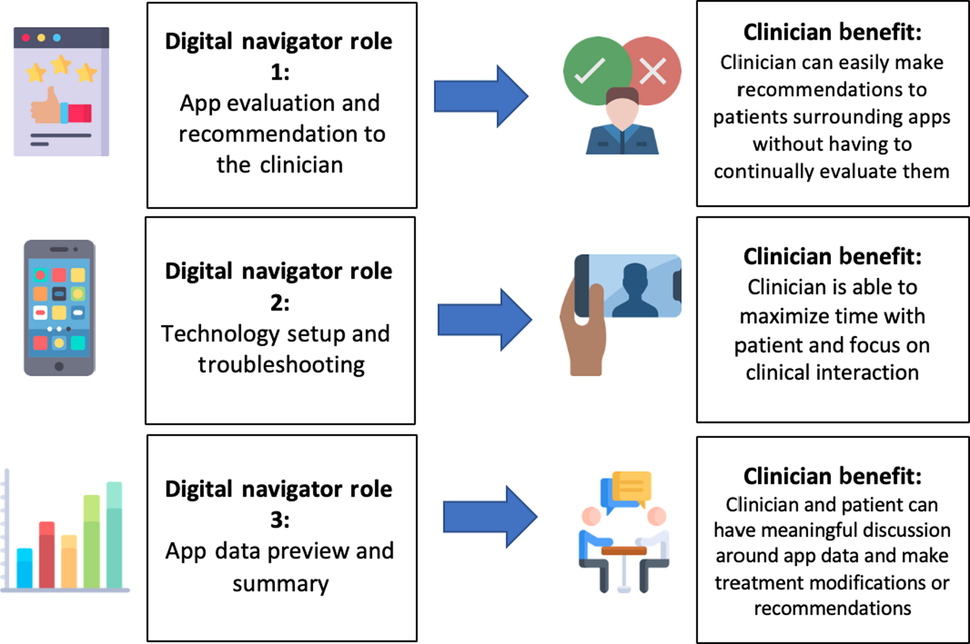
Digital navigators
We may see “digital navigators” appear more often as a new care team member in clinical settings
(Wisniewski & Torous, 2020)
You may not have access to a digital navigator, but considering their roles can help you learn how to be your own digital navigator

Slide 56
Your “homework”…
ACTION ITEM: Take some time to try out a few apps/technologies that stood out to you
Use the worksheet to develop your own list
https://bit.ly/3h2QZSF
Take notes on…
How you would use them (To maintain gains? For skills practice?)
With whom you would use them (All clients? Clients who are struggling to apply skills outside of therapy?)
Tech handout: https://bit.ly/2C9txEK
Have these notes/list readily available to use in conjunction with treatment planning

Slide 57
How do we engage clients in using these technologies?

Slide 58
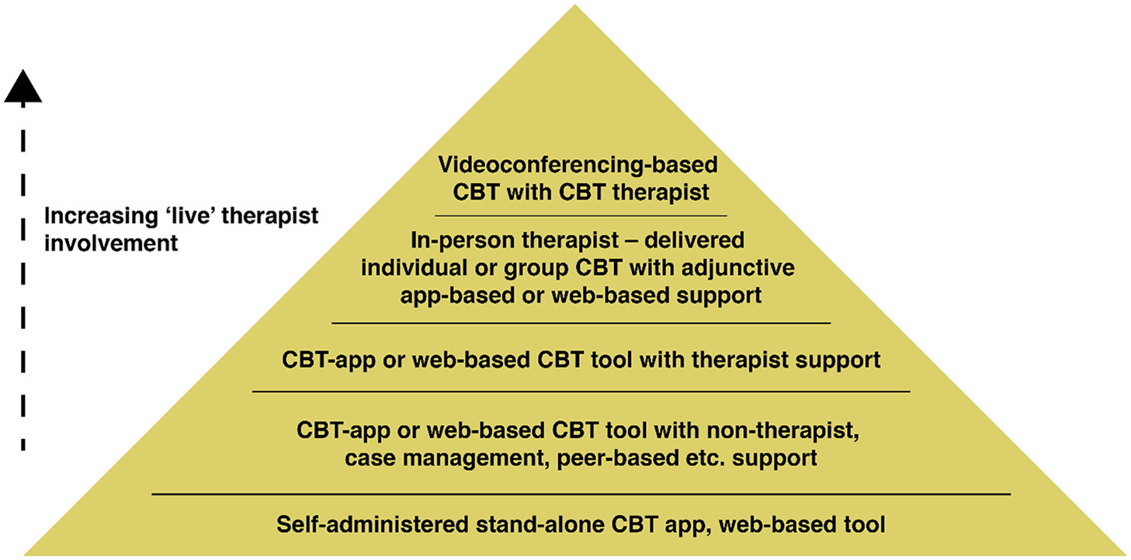
Levels of support
What is the relationship between your support as a therapist and the app?
Are you supporting the client’s use of app, is the app supporting your work with the client, or both?
Think about what level of support you want to provide before introducing the program
Muroff & Robinson, 2020

Slide 59
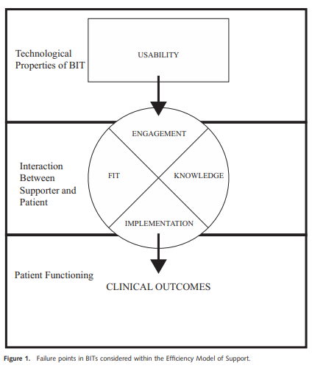
Resource efficiency model
Failure points in using a program with a client
Usability: Poorly design app results in barriers
E.g., app is not selected with care, and is difficult for client to use
Engagement: Client does not use program
E.g., client is not motivated to use the app
Fit: Program does not meet client’s needs
E.g., stress reduction app for client who does not have stress
Knowledge: Client uses program incorrectly
E.g., client entering an emotion when prompted for a thought
Implementation: Client does not generalize what they learn
E.g., app teaches defusion skill, but client doesn’t use it in daily life
Schuller, Tomasino, & Mohr, 2017

Slide 60
Resource efficiency model
Once you identify a failure point… what do you do about it?
Engagement, knowledge, and implementation should be continuously addressed
Supportive accountability is one lens

Slide 61
Supportive accountability
Empirically supported, theory-based model for improving adherence to self-help technologies
Human support increases adherence
Clear accountability can further increase adherence
This is a model for understanding guided self-help
Can be implemented in a variety of contexts including face-to-face, email and phone calls

Slide 62
Principles of supportive accountability
Clarify expectations: in using program, adherence, receiving support from you, and why
Adherence expectations: How they are expected to use the program
Receiving support: If/how they will be monitored, be held accountable, and be contacted about the app
Role of support: This is to support them and their goals, no negative consequences for not following through

Slide 63
Principles of supportive accountability
Motivation: Develop intrinsic motivators for engagement
How program is important, applies to person, fits with values, can be helpful, etc…
Choice: Provide choice and identify areas they have choice.
Goal setting: Set adherence goals linked to larger values
Set adherence goals collaboratively

Slide 64
Principles of supportive accountability
Social presence: Sense of a human being involved can improve adherence.
Monitoring: Monitoring adherence is key.
Check in calls, quizzes, program usage logs
Clarify what you have access to (therapists may worry about this more than clients)
Address adherence level: Encourage meeting goals and address non-adherence

Slide 65
Introducing technologies
Go over the program and roles
Link program to case conceptualization and client goals
Elicit and reinforce motivation to use program
Identify barriers and problem solve
Elicit commitment to adhere to program (and to process of coaching, if applicable)

Slide 66
Typical call procedure
Brief coaching calls can supplement app use/therapy
Motivate use of the program
Reinforce engagement in the program
What did they like? Not like? What did they learn?
Elicit commitment to program
Address non-adherence
Troubleshoot any problems

Slide 67
Addressing Non-Adherence
Remember accountability
Ask them why the adherence goal wasn’t met.
Remember support
Connect the goal back to larger goals and values
Collaboratively problem solve solutions
Identify and address barriers to adherence.

Slide 68
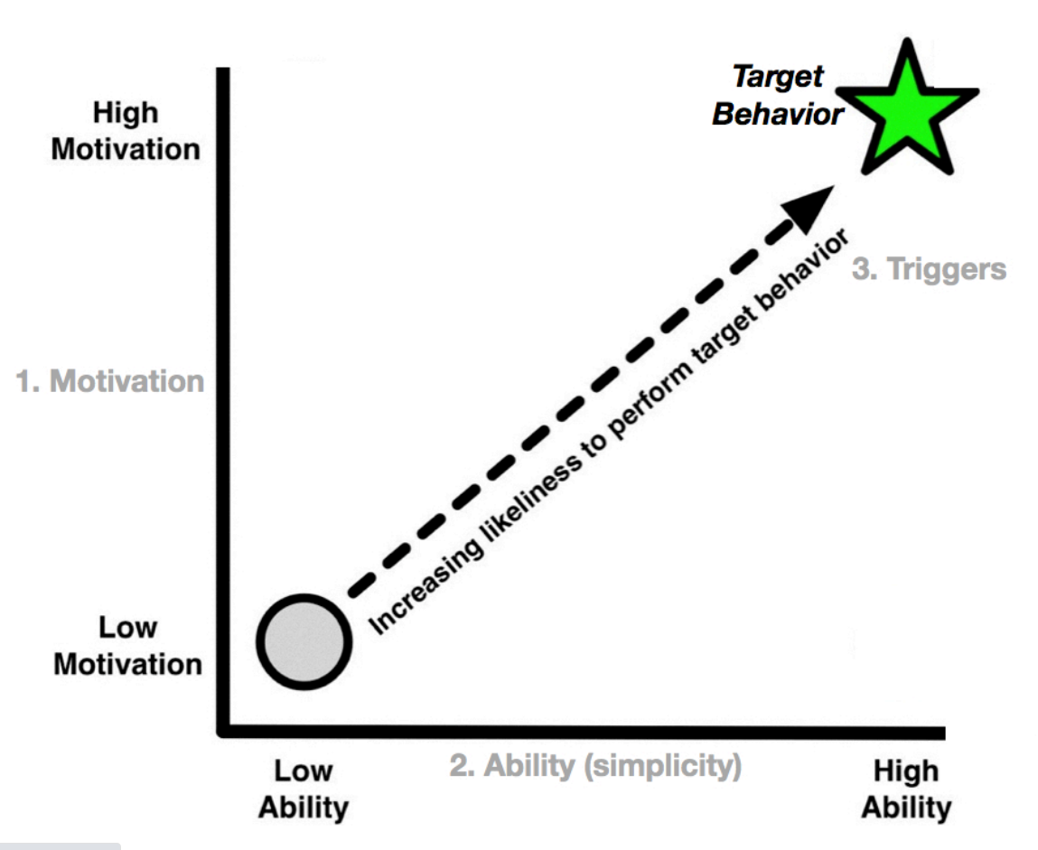
Problem solving with the Fogg Behavior Model (FBM)
Strategy for persuasive design to help people do the things they already want to do (Muroff & Robinson, 2020)
Three factors
Motivation
Connected to values
Ability (perceived ease)
Does the client have the necessary
resources? Time, cognitive load, etc.
Triggers (prompts)
Alarms
Push notifications

Slide 69
Problem solving with the Fogg Behavior Model (FBM)
Motivation
Try to leverage naturally occurring motivation, instead of relying on instilling motivation
Ask the client about when they experience the most motivation to use the app, and plan app use around those times
E.g., 1 hour before therapy, for 24 hours after therapy, after accomplishing other tasks (increased self efficacy), etc.
Plan rewards for use (Premack principle)

Slide 70
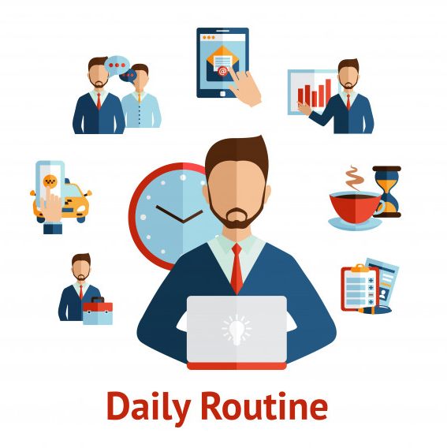
Problem solving with the Fogg Behavior Model (FBM)
Ability/perceived ease
Metaphors can leverage existing cognitions to make app use more approachable
Brain can be trained like a muscle… but it takes consistent use over time
Integrate app use into routine
Decrease demand on time
“Try doing it for just 2 minutes and see what happens”
This can help with defusing from the thought “I don’t have enough time” too

Slide 71
Problem solving with the Fogg Behavior Model (FBM)
Triggers/prompts
Reminders (push notifications, alarms, etc.) can be scheduled when motivation and ability is highest
E.g., ability might be higher during lunch breaks
Pair reminder with activity that is already routine (e.g. after breakfast)
Having a client walk through an average day can be helpful for identifying times for prompts

Slide 72
What if I don’t have time to check in?
Solution 1: Target supportive accountability in session only
Each of these principles could be targeted in session.
Solution 2: Setup clear expectations and structure to minimize time required outside of session
Consider email or text message if clinically indicated and complies with confidentiality concerns.

Slide 73
How and when do I review app data?
Solution 1: Review the data with clients in session.
Solution 2: Use apps that can send data to you in a secure format so you can review ahead of time.
But let your clients know that this is likely right before session or during session.
You won’t follow up about their data during the week (unless you will).
Consider if data will be collected that could raise liability concerns.

Slide 74
How do I address engagement over time?
Solution 1: Help switch up what app they use on a routine basis.
Solution 2: Build app usage as a habit.
Treating app usage as a habit; find when its convenient to use app
Solution 3: Consider how long they need to use the app.
Are a couple weeks sufficient? When is it appropriate to “terminate” use of the app?

Slide 75
What if a client reacts negatively or the app provides contraindicated content?
Solution 1: Review the app ahead of time to know what it includes.
Address any potential miscommunications or issues ahead of time with client.
Solution 2: Monitor how clients use and respond to the app.
Catch negative reactions or concerning responses to the app.
Solution 3: Address inconsistencies and issues.
Clarify how the app might differ from approach in therapy.
Emphasize client’s experience for what works.
Avoid being judgmental just because its not the way you would do it.

Slide 76
How do I encourage ongoing app use after therapy ends?
Solution 1: Clarify termination and the role of the app.
They can use the app as a support to keep working on skills.
You will not have access to their data and therapy is finished.
Solution 2: Teach clients how to keep using apps.
How to choose new apps well, what to look for, etc…
Give them a list of apps to use.
But also help them get oriented to using one app to promote adoption.

Slide 77
Steps for going further
Learn more about ACT and technology
Send us questions or feedback (Mike.Levin@usu.edu and k.klimczak@aggiemail.usu.edu)
Visit our website at https://www.utahact.com
Join the ACTing with Technology SIG
Attend the networking event Saturday, July 18: 3:45 PM - 4:30 PM CDT
Ask colleagues about their experiences with apps.
Try out some apps to see what you like and don’t like
Actively use an app with a few engaged, tech savvy clients

Slide 78
Steps for going further
BREAK OUT GROUPS!
What is something that you learned that you can practically apply?
How/when will you apply this in your work?
Commit to ONE concrete action!

Slide 79
What will you do with what you learned today?
Type how you plan on using what you learned today in your work or practice into the chat box

Slide 80
Questions?
K.Klimczak@aggiemail.usu.edu and Mike.Levin@usu.edu
Visit our website at https://www.utahact.com
Follow us on Facebook at https://www.facebook.com/UtahACT
ACT Guide Self-Help Program: https://scce.usu.edu/services/act-guide/
Tech handout: https://bit.ly/2C9txEK
Tech worksheet: https://bit.ly/3h2QZSF

Slide 81
Apps/resources recommended by our ACBS 2020 attendees - Mindfulness
Insight Timer
“When I recommend it I also always recommend specific recordings to ensure what clients are listening to actually adheres to the ACT framework”
“The ones I use most often are ‘Breathing Meditation” (5min) by UCLA Mindful Awareness Research Center and “Thoughts as Leaves on a Stream” (5min) by Katie Hirst MD
“I have used it for 8+ years. I text a meditation to a client after session that fits the hexaflex process I think they need. There are hundreds of experiential guided meditations with secular/ACT/CFT meditation teachers.”
“You can go to settings and request ONLY evidence-based meditations.”
Mindfulness Bell
“You can program it to randomly ding (great for present moment awareness or building new skill habits)”
Mindfulness Coach
Petit Bambou
Exists in Spanish, French, German, and English
10PercentHappier

Slide 82
Apps/resources recommended by our ACBS 2020 attendees – Self-monitoring/tracking
MoodPath
Mood tracking
Daylio
Mood tracking
Jour
Journaling app that allows you to go back and review previous entries
Todoist
To-do list app
“I didn’t have the discipline to use it consistently but I have recommended it to others who found it helpful”

Slide 83
Apps/resources recommended by our ACBS 2020 attendees - Children
Mindful Powers
Mindfulness app for kids
Sitting Still Like a Frog
There’s a book as well as app
Magis – The Magical Adventure
Mobile game for kids modeling ACT, targeted for ages 9-11

Slide 84
Apps/resources recommended by our ACBS 2020 attendees – Other
BreathingApp
Breathing training for better health
Secrets of Happiness
Gratitude app
Emood
For bipolar
NOCD
For OCD
PE Coach
For PTSD

Slide 85
Apps/resources recommended by our ACBS 2020 attendees – Websites/videos
Relational Frame Theory (RFT) From your ACT Auntie
https://www.youtube.com/watch?v=XvnEn1Y-gcQ
https://www.anxietycanada.com/
http://mindflex.com/
Used to comprehensively track psychological flexibility, depression, & wellbeing in treatment
https://ncase.me/neurons/
https://portlandpsychotherapy.com/resources/acceptance_and_commitment_therapy_exercises_and_audiofiles/
https://psych.ucsf.edu/coronavirus

